Slide 1
What is the Candidate Elimination Algorithm?
The Candidate Elimination Algorithm is a method for learning a concept from a set of positive and negative examples. It incrementally refines the hypothesis space by generalizing and specializing the hypotheses to arrive at the most specific and general hypotheses consistent with the examples.
In concept learning, we have a dataset of objects labeled as either positive or negative. The positive ones are members of the target concept, and the negative ones aren’t. Our goal is to formulate a proper concept function using the data, and the Candidate Elimination Algorithm (CEA) is a technique for doing precisely so.
For each positive example, generalize the specific hypothesis to cover the example.
For each negative example, specialize the general hypotheses to exclude the example.
CEA finds the version space V by identifying its general and specific boundaries, G and S. G contains the most general hypotheses in V, whereas the most specific ones are in S.
Specific Hypothesis (S): The most specific hypothesis that covers all positive examples seen so far.
General Hypothesis (G): The most general hypothesis that covers all positive examples and excludes negative examples.

Slide 2

Example: - Weather

Slide 3
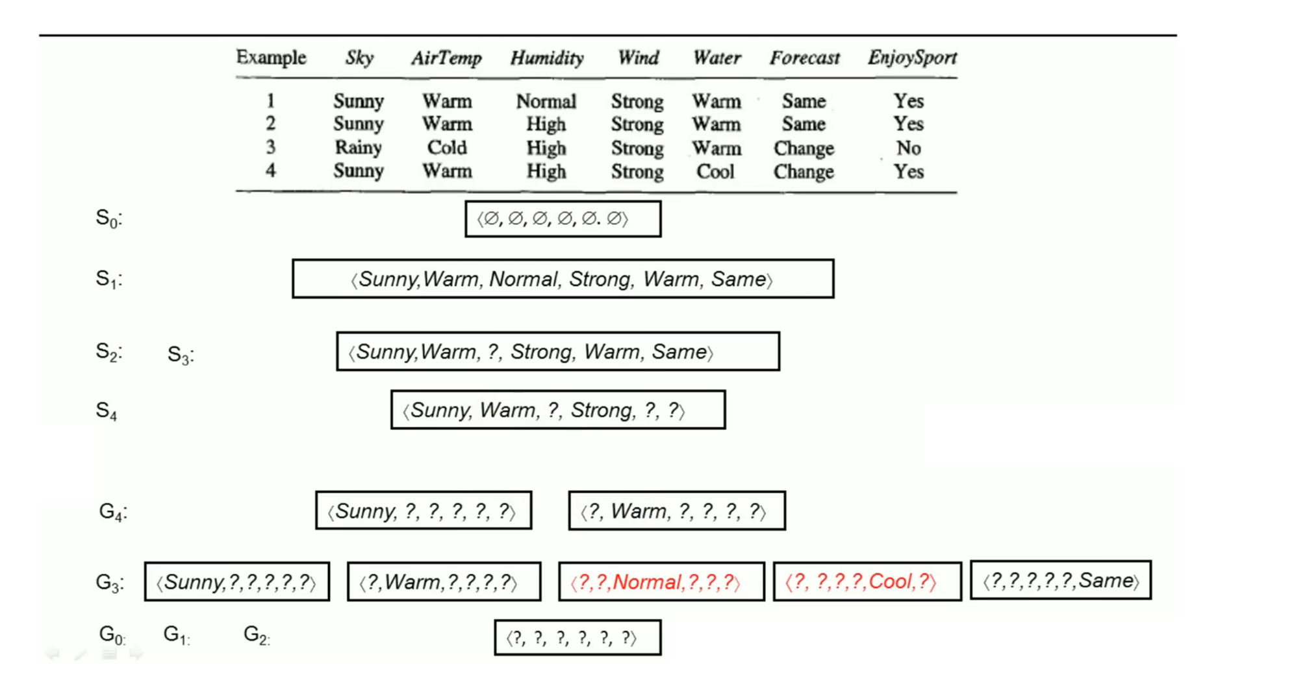

Slide 4
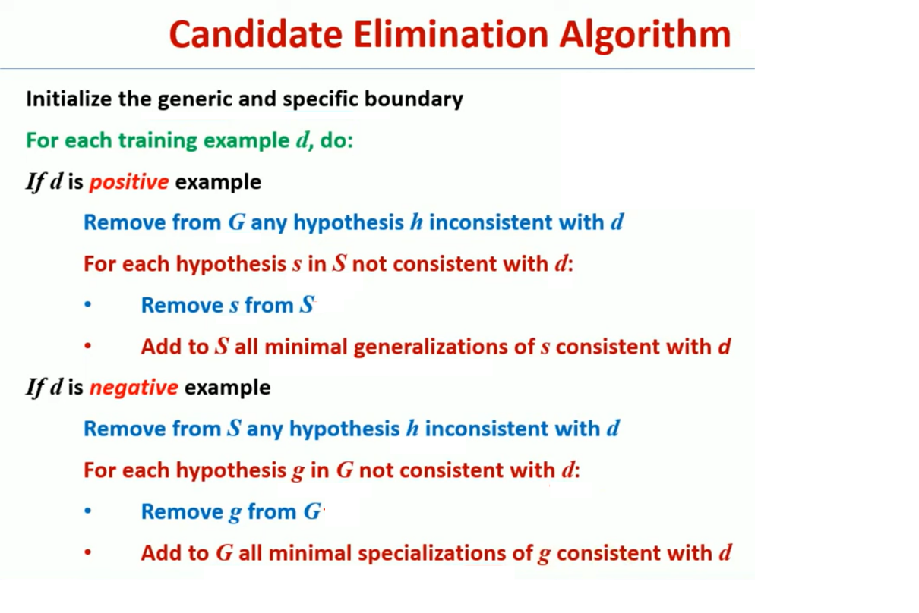

Slide 5
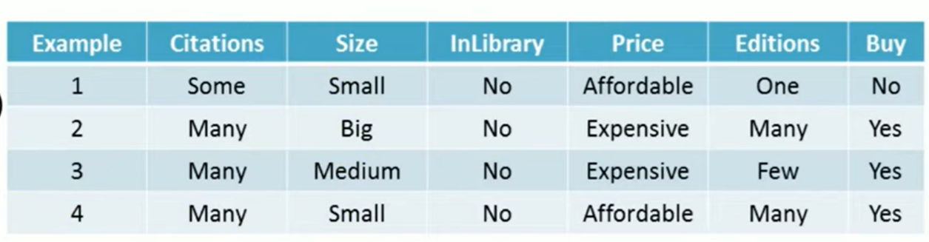
Example

Slide 6
